Slide 1
CUSTOMER RELATIONSHIP MANAGEMENT
Lead & Opportunity

Slide 2
Summary
This project focused on analyzing customer relationship management (CRM) data in the lead and opportunity stages to derive actionable insights for business growth. We utilized separate datasets for leads and opportunities, performing extensive data cleaning and analysis to create key performance indicators (KPIs).
Key objectives included:
Identifying patterns in lead and opportunity conversion rates
Understanding the effectiveness of different opportunity types and lead sources
Evaluating overall sales performance through KPIs like win/loss rates, total amounts, and conversion rates.
Through this analysis, we provide valuable metrics for optimizing CRM strategies, improving sales forecasting, and enhancing decision-making for business development teams.

Slide 3
Key Performance Indicators
Opportunity
Expected Amount
Active opportunities
Conversion Rate
Win Rate
Loss Rate
Expected Amount by Opportunity types
Opportunities by industry
Lead
Total Leads
Expected Amount by converted opportunities
Conversion Rate
Converted accounts
Converted opportunities
Lead by source
Lead by industry

Slide 4
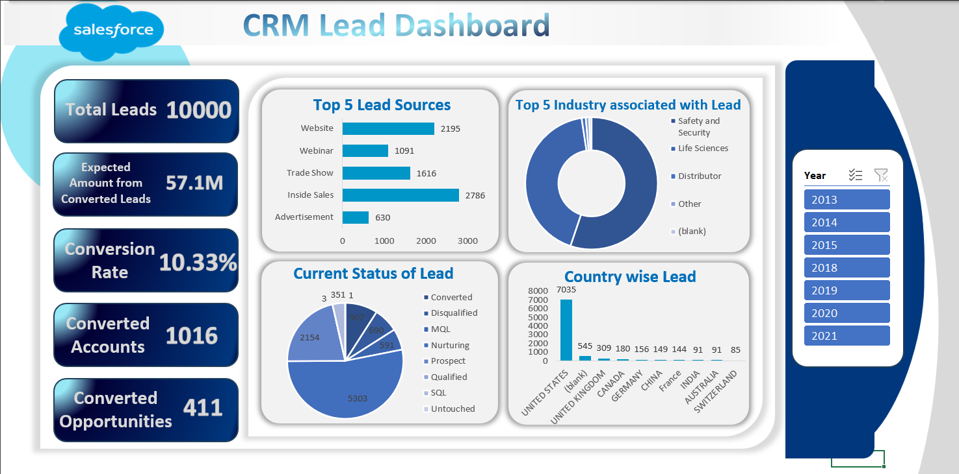
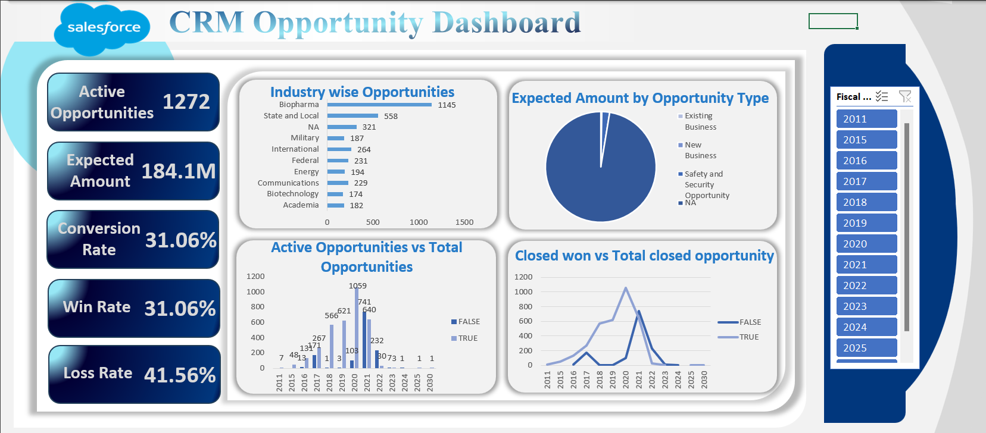

Slide 5
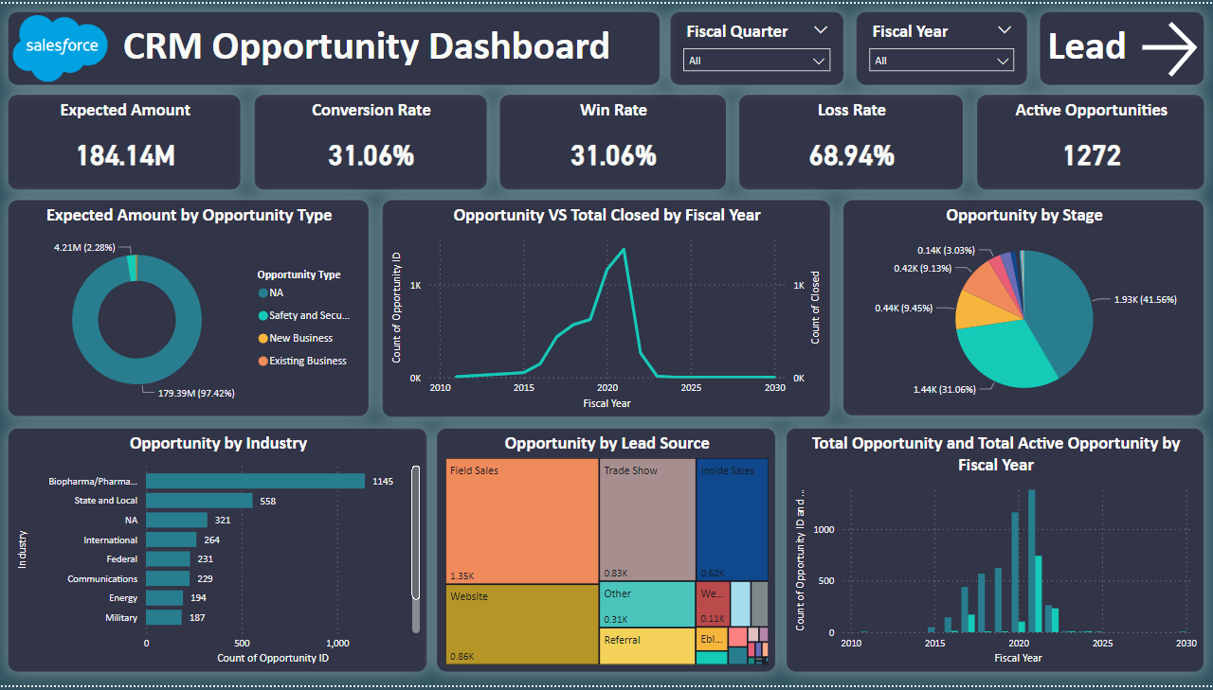
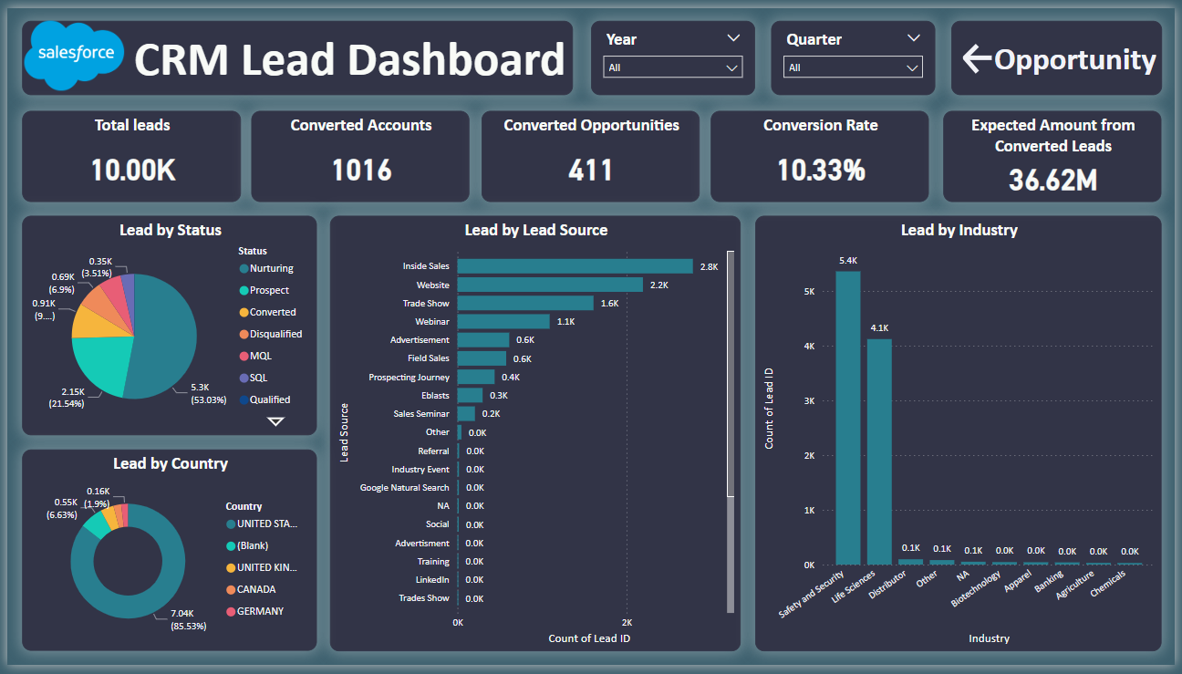

Slide 6
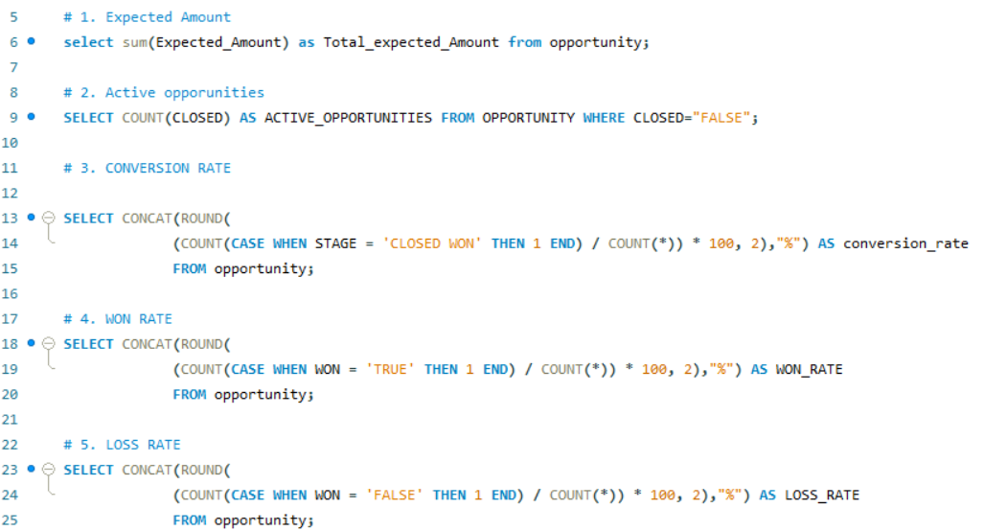
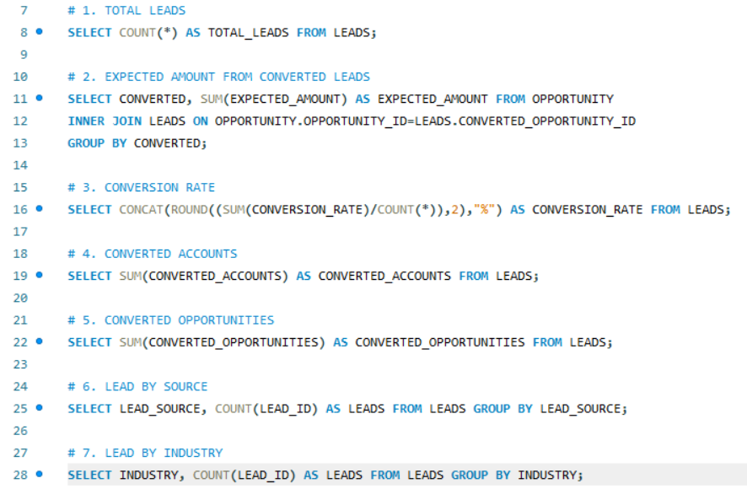

Slide 7
Key Takeaways
Lead Conversion Insights
Conversion Rate: Identified trends in lead-to-opportunity conversion, highlighting areas where additional nurturing can improve outcomes.
Lead Sources: Analyzed performance by lead source to optimize marketing efforts and focus on high-performing channels.
Opportunity Management
Win Rate: High win rates were correlated with specific opportunity types, emphasizing the importance of targeting the right customer segments.
Loss Rate: Examined factors contributing to lost opportunities, providing insights for improving sales strategies and customer engagement.
3.Revenue Forecasting
Expected Amount by Opportunity Type: Enabled better prediction of revenue by analyzing the potential amount tied to different types of opportunities.
Expected Revenue from Leads: Forecasted expected revenue from leads that converted, helping to refine future lead generation strategies.
4.Industry Trends
Both lead and opportunity data revealed industry-specific trends that can guide tailored CRM strategies for different sectors.

Slide 8
Thank You

